Slide 1

CSE3251
Computer Networks
Dr. Asif Zaman
Professor, CSE, RU

Slide 2
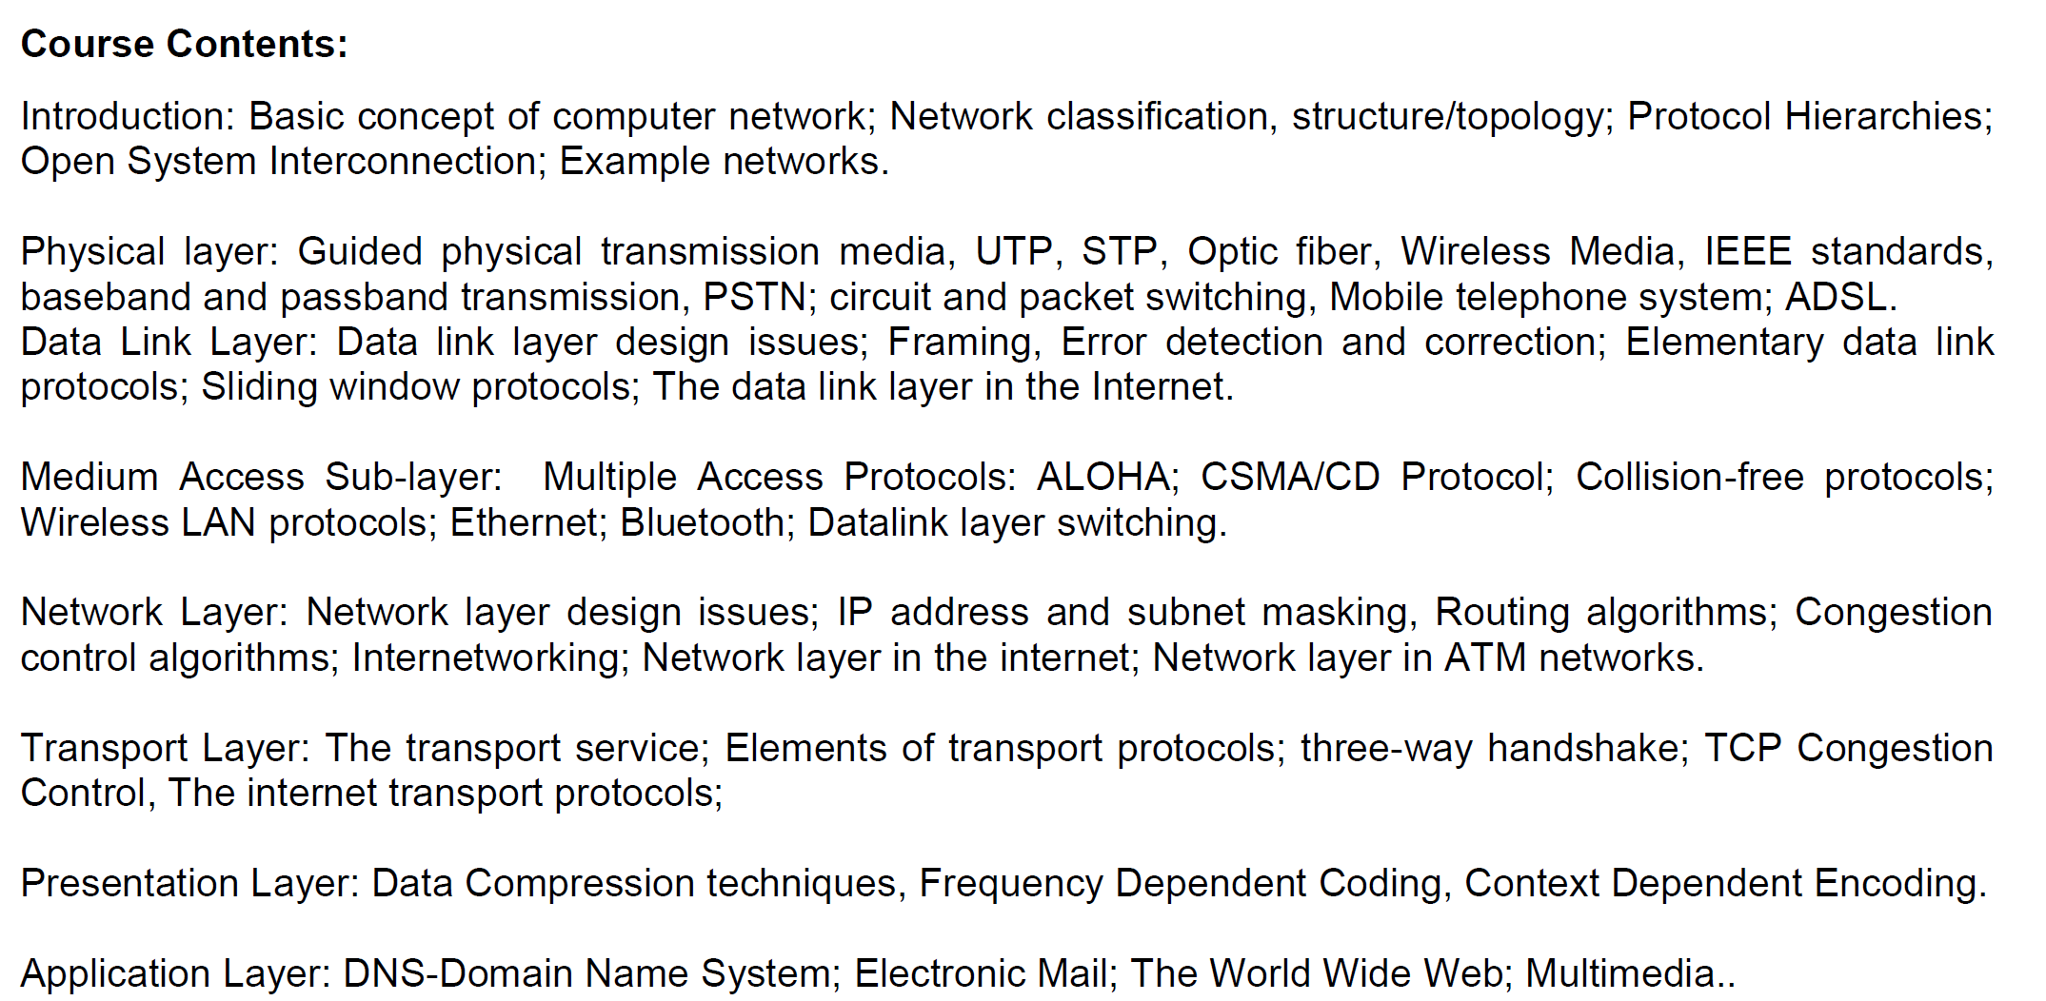

Slide 3
Medium Access Sublayer

Slide 4
The Data Link Layer
The main task of the data link layer is to transform a raw transmission facility into a line that appears free of undetected transmission errors.
It accomplishes this task by having the sender break up the input data into data frames (typically a few hundred or a few thousand bytes) and transmit the frames sequentially.
The receiver confirms correct receipt of each frame by sending back an acknowledgement frame.

Slide 6
Medium Access Sublayer
The protocols used to determine who goes next on a multi-access channel
The MAC sublayer is especially important in LANs, particularly wireless ….

Slide 7
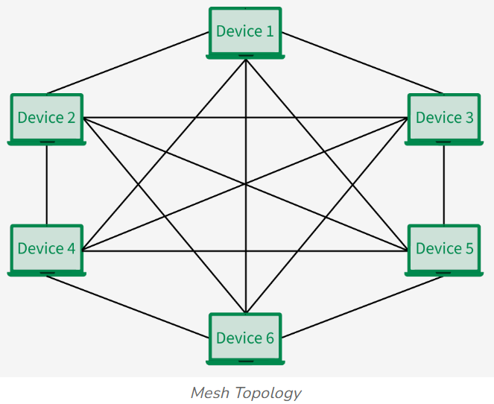
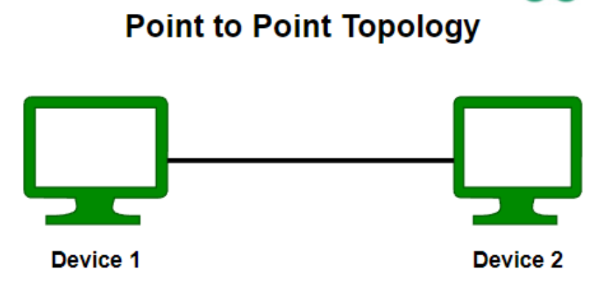
Topology (Layer 1)
Types of Network Topology
Point to Point Topology
Mesh Topology
Star Topology
Bus Topology
Ring Topology
Tree Topology
Hybrid Topology

Slide 8
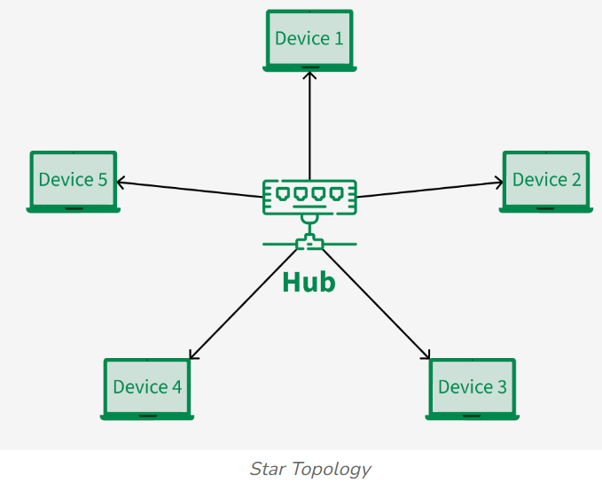
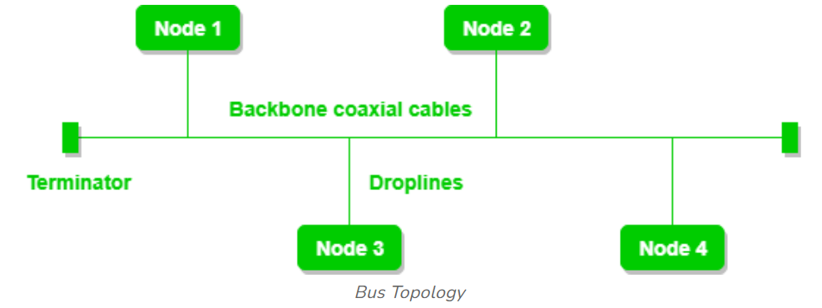
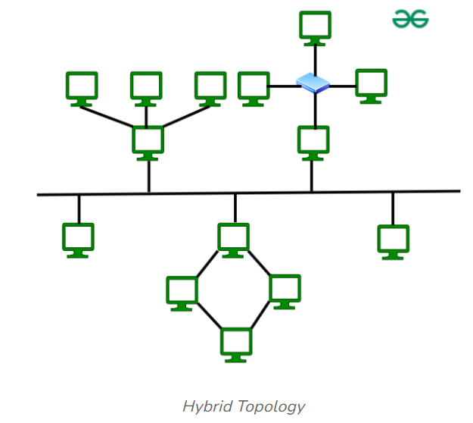
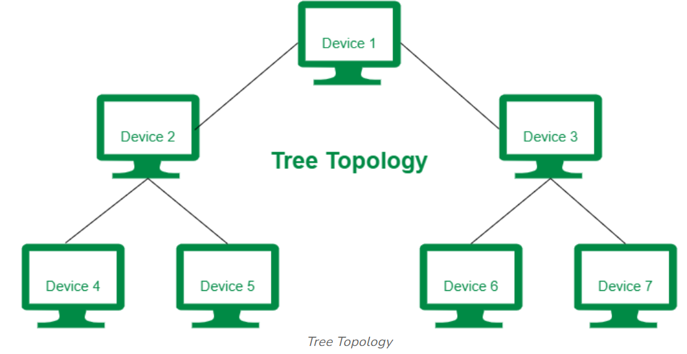
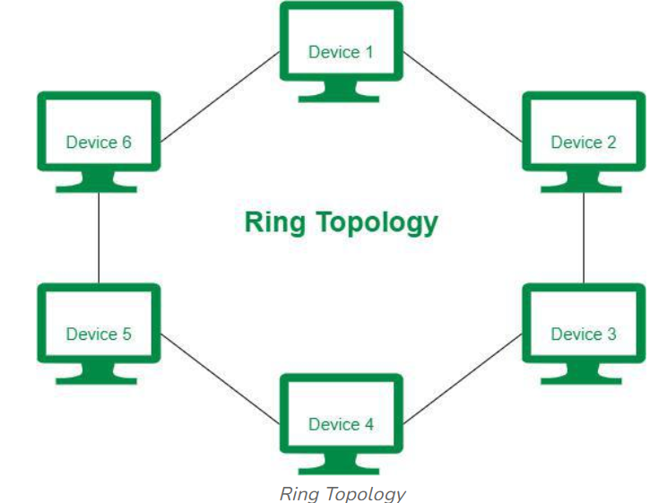

Slide 9
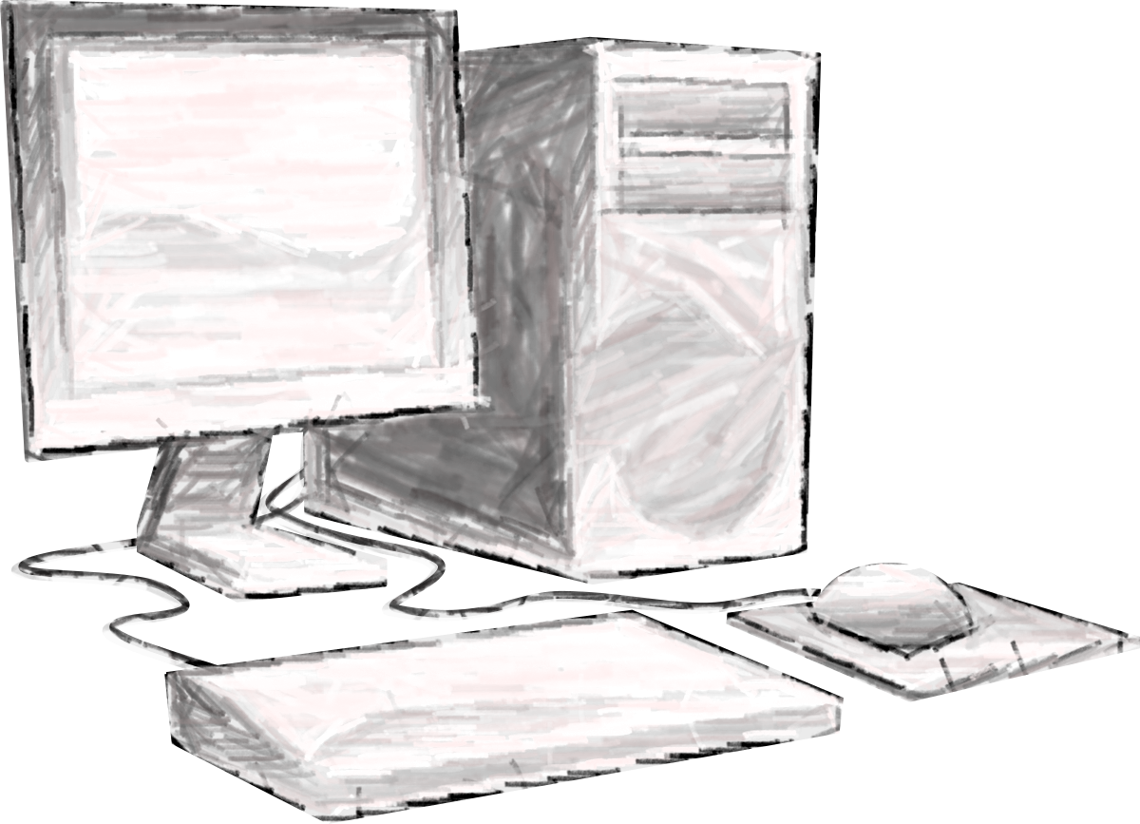
The Channel Allocation Problem
Two Schemes:
Static Channel Allocation
Dynamic Channel Allocation
A
B
C
X

Slide 10
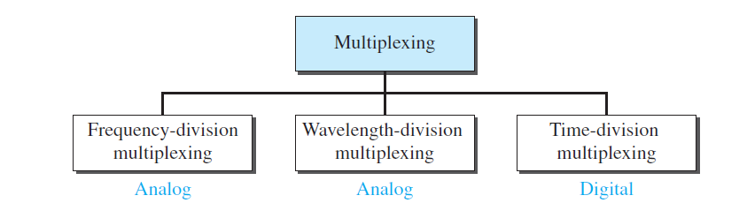
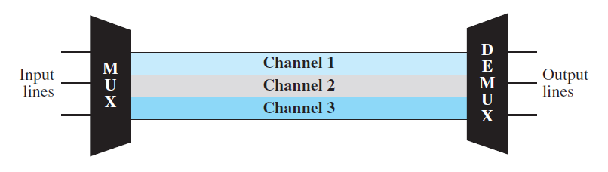
Frequency-Division Multiplexing:
FDM is an analog technique that can be applied when the bandwidth of a link (in hertz) is greater than the combined bandwidths of the signals to be transmitted.

Slide 11
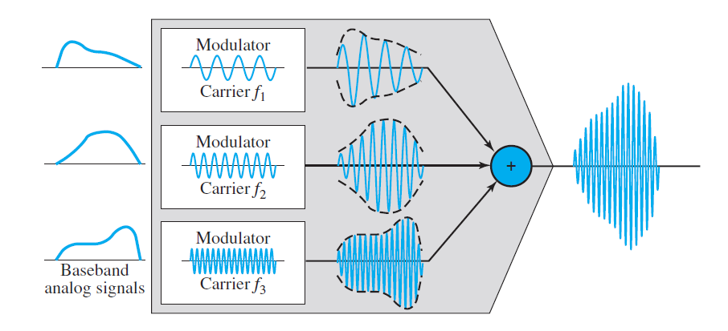
Each source generates a signal of a similar frequency range.
Inside the multiplexer, these similar signals modulate different carrier frequencies ( f1, f2, and f3).
The resulting modulated signals are then combined into a single composite signal that is sent out over a media link that has enough bandwidth to accommodate it.

Slide 12
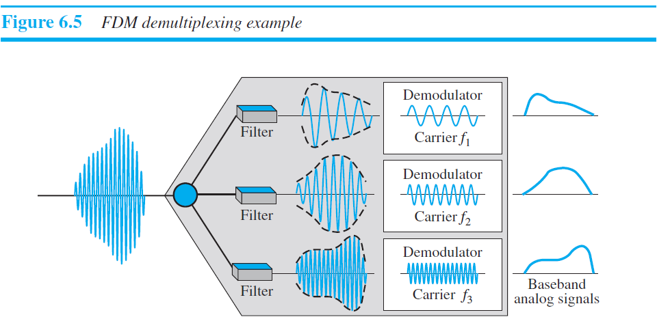
The demultiplexer uses a series of filters to decompose the multiplexed signal into its constituent component signals.
The individual signals are then passed to a demodulator that separates them from their carriers and passes them to the output lines.

Slide 13
Static Channel Allocation
FDM (Frequency Division Multiplexing).
User needed to be constant N
When some users are quiescent, their bandwidth is simply lost.
A static allocation is a poor fit to most computer systems… peak traffic to mean traffic ratios of 1000:1
Most of the channels will be idle most of the time

Slide 14
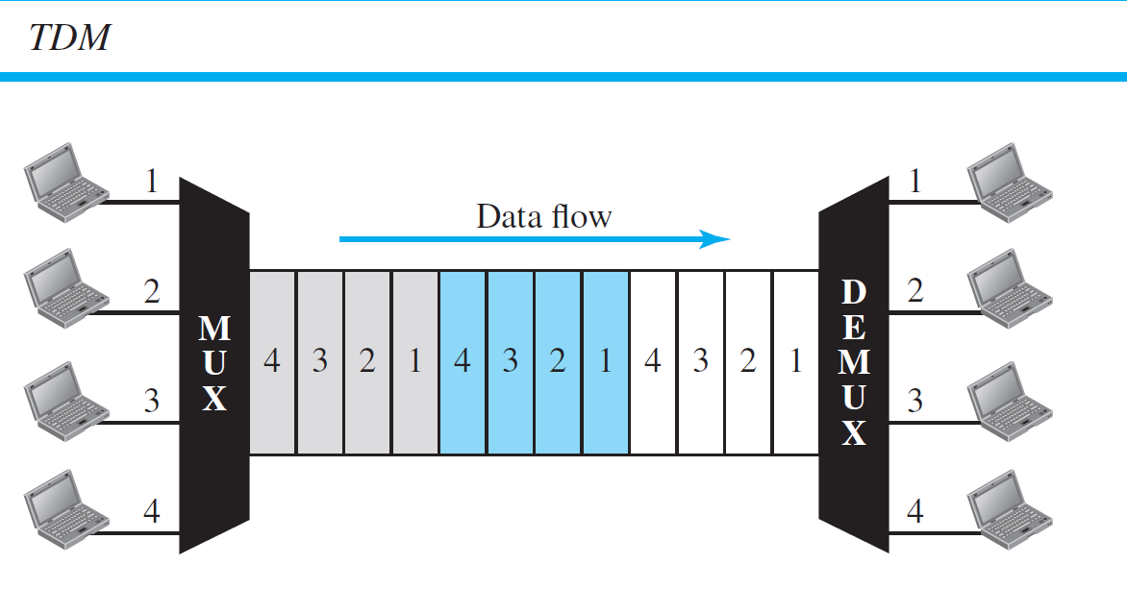
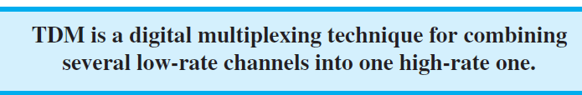
Time-Division Multiplexing (TDM)

Slide 15
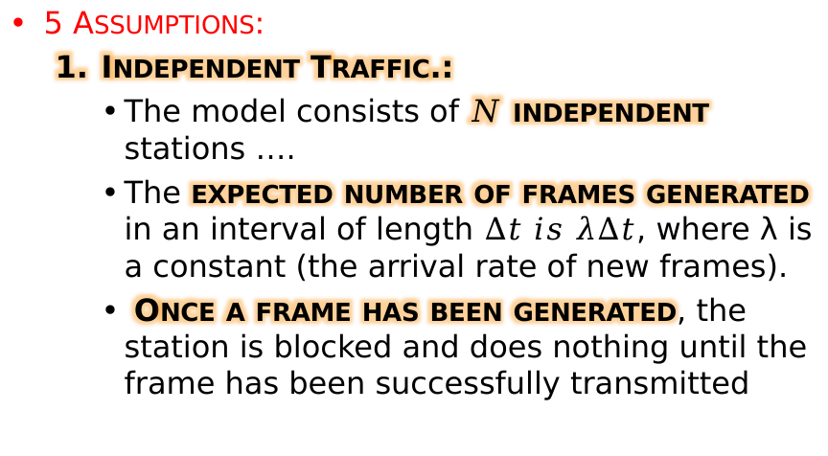
Dynamic Channel Allocation
5 Assumptions:
Independent Traffic.:
The model consists of $N$ independent stations ….
The expected number of frames generated in an interval of length $Δt is λΔt$, where λ is a constant (the arrival rate of new frames).
Once a frame has been generated, the station is blocked and does nothing until the frame has been successfully transmitted

Slide 16
Dynamic Channel Allocation
Single Channel.
A single channel is available for all communication.
All stations can transmit on it and all can receive from it.
Observable Collisions.
If two frames are transmitted simultaneously, they overlap in time and the resulting signal is garbled.
This event is called a collision.
All stations can detect that a collision has occurred.
A collided frame must be transmitted again later. No errors other than those generated by collisions occur

Slide 17
Dynamic Channel Allocation
Continuous or Slotted Time.
Time may be assumed continuous, in which case frame transmission can begin at any instant.
Alternatively, time may be slotted or divided into discrete intervals (called slots).
Frame transmissions must then begin at the start of a slot.
A slot may contain 0, 1, or more frames, corresponding to an idle slot, a successful transmission, or a collision, respectively.

Slide 18
Dynamic Channel Allocation
Carrier Sense or No Carrier Sense.
With the carrier sense assumption, stations can tell if the channel is in use before trying to use it.
No station will attempt to use the channel while it is sensed as busy.
If there is no carrier sense, stations cannot sense the channel before trying to use it.
They just go ahead and transmit.
Only later can they determine whether the transmission was successful

Slide 19
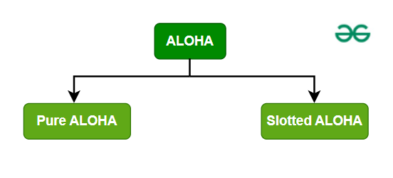
Multiple Access Protocols
Popular Dynamic Channel Allocation Protocol:
ALOHA (Advocates of Linux Open-source Hawaii Association)
Pure ALOHA protocol (created at the University of Hawaii in the early 1970s.)
Slotted ALOHA protocol

Slide 20
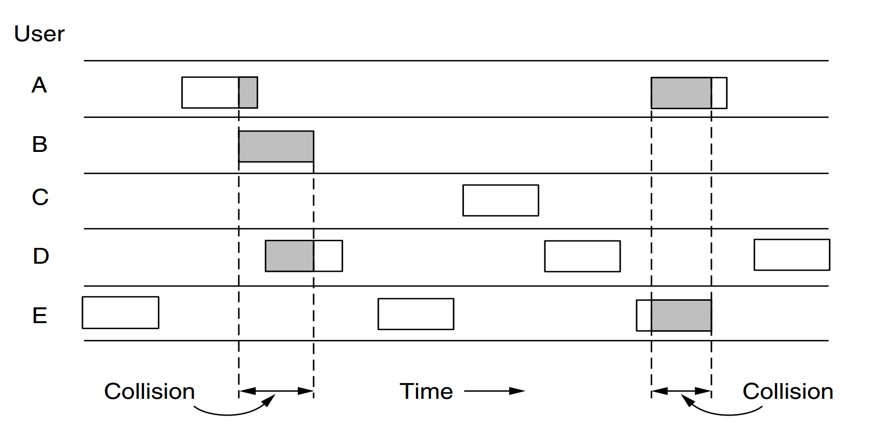
Pure ALOHA
Systems in which multiple users share a common channel in a way that can lead to conflicts are known as contention systems
Notes:
Let users transmit whenever they have data to be sent.
There will be collisions, of course, and the colliding frames will be damaged. Senders need some way to find out if this is the case.
After each station has sent its frame to the central computer, this computer rebroadcasts the frame to all of the stations.
A sending station can thus listen for the broadcast from the hub to see if its frame has gotten through.
If the frame was destroyed, the sender just waits a random amount of time and sends it again.

Slide 21
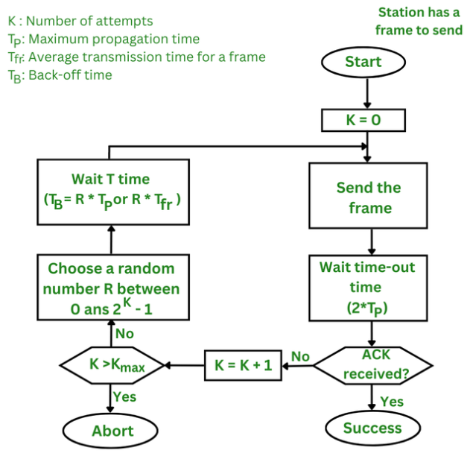

Slide 22
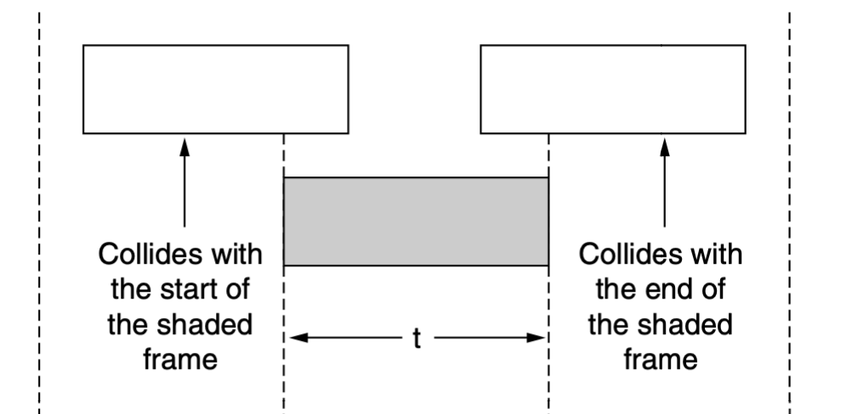
Collision?

Slide 23
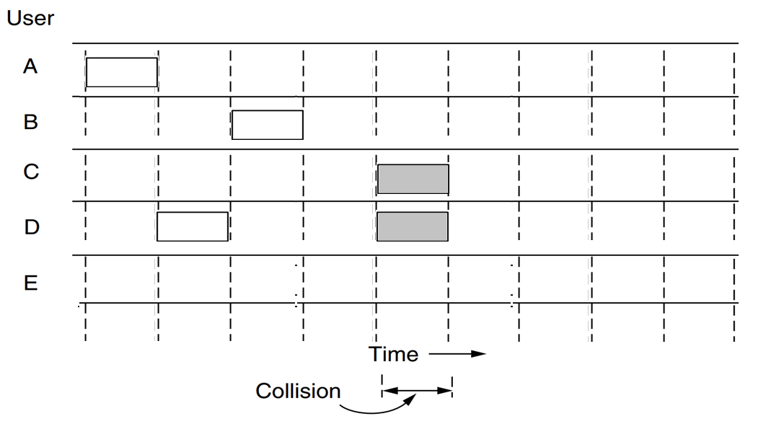
Slotted ALOHA
… proposal was to divide time into discrete intervals called slots, each interval corresponding to one frame
This approach requires the users to agree on slot boundaries.
One way to achieve synchronization would be to have one special station emit a pip at the start of each interval, like a clock.
it is required to wait for the beginning of the next slot

Slide 24
Assumption of Slotted ALOHA
All frames are of the same size.
Time is divided into equal-sized slots, a slot equals the time to transmit one frame
Nodes start to transmit frames only at beginning of slots.
Nodes are synchronized.
If two or more nodes transmit in a slot, all nodes detect collision before the slot ends.

Slide 25
Carrier Sense Multiple Access Protocols
Carrier Sense Multiple Access Protocols – CSMA
Protocols in which stations listen for a carrier (i.e., a transmission) and act accordingly are called carrier sense protocols
Persistent and Nonpersistent CSMA
Persistent – Non-Stop

Slide 26
1- Persistent CSMA Protocol

Slide 27
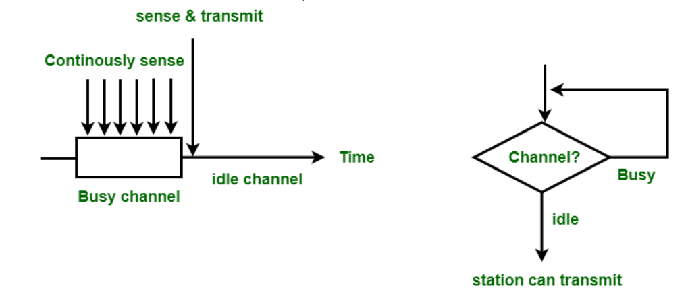
1- Persistent CSMA Protocol
When a station has data to send:
It first listens to the channel to see if anyone else is transmitting at that moment.
If the channel is idle, the stations sends its data.
if the channel is busy, … waits until it becomes idle. Then the station transmits a frame
if a collision … waits a random amount of time and starts all over again.
The protocol is called 1-persistent because the station transmits with a probability of 1 when it finds the channel idle

Slide 28
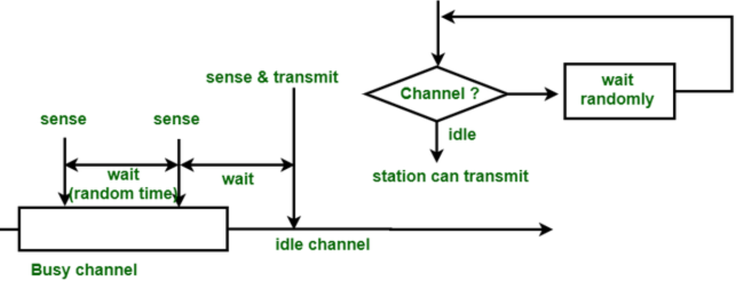
Nonpersistent CSMA
A station senses the channel when it wants to send a frame, and if no one else is sending, the station begins doing so itself.
However, if the channel is already in use, the station does not continually sense it for the purpose of seizing it immediately upon detecting the end of the previous transmission.
Instead, it waits a random period of time and then repeats the algorithm.

Slide 29
P-persistent CSMA
It applies to slotted channels and works as follows.
When a station becomes ready to send, it senses the channel.
If it is idle, it transmits with a probability p.
With a probability q = 1 − p, it defers until the next slot.
If that slot is also idle, it either transmits or defers again, with probabilities p and q.
This process is repeated until either the frame has been transmitted or another station has begun transmitting.
if there had been a collision - it waits a random time and starts again.
If the station initially senses that the channel is busy, it waits until the next slot and applies the above algorithm.

Slide 30

CSMA with Collision Detection
CSMA with Collision Detection – CSMA/CD
C
D
$$λ$$
A
B

Slide 31
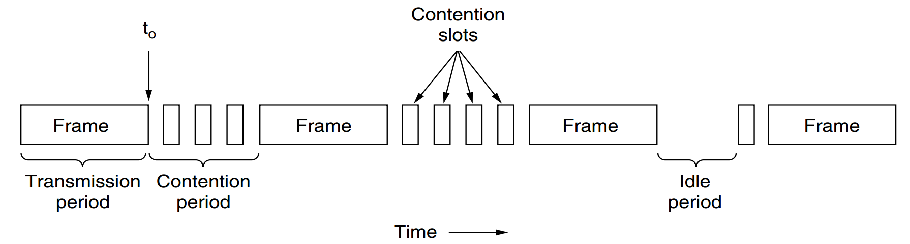
CSMA with Collision Detection

Slide 32
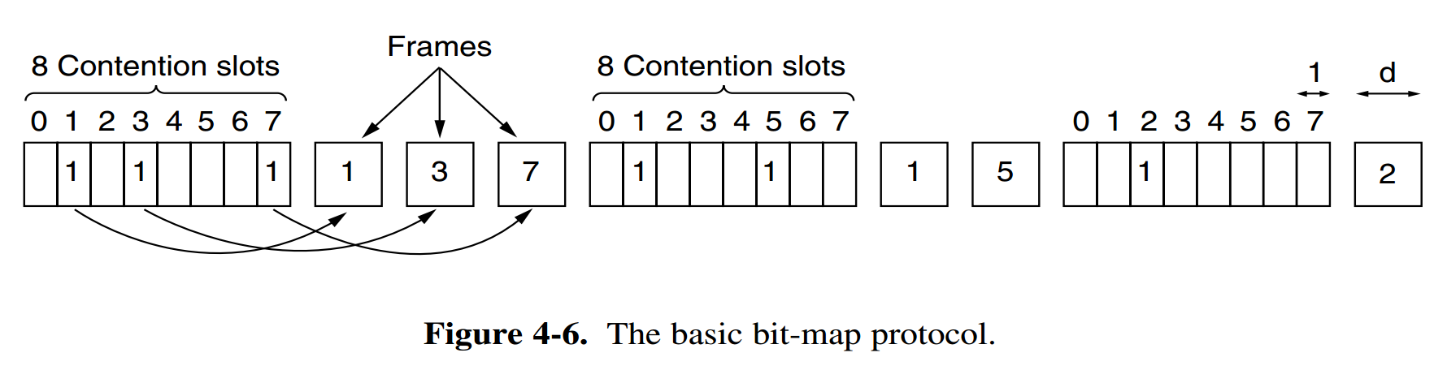
Collison Free Protocol
A Bit-Map Protocol

Slide 33
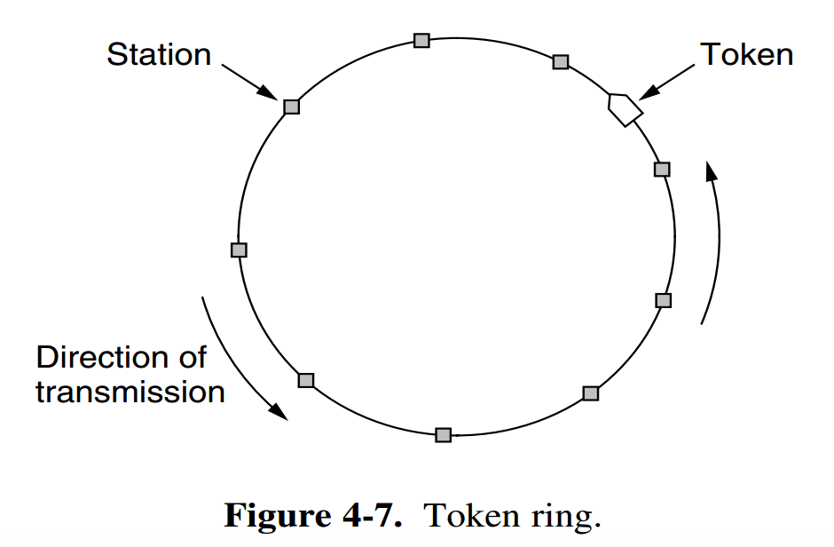
Collison Free Protocol
Token Passing

